Slide 1
Overview of Performance Management Processes

Slide 2
Agenda
Annual Performance Review Process
Pfenex’s Performance Management Philosophy
Performance Review Eligibility
Performance Management Process
Self-Evaluation Overview
Writing Performance Review
Rating Definitions
Leadership Competencies Evaluation
Preparation for Performance Review Discussion (managers)
Timeline
FAQs

Slide 3
Pfenex’s Philosophy
Annual Performance Review Process
Pfenex
- Provides systems, tools and training
Managers
- Set Expectations
- Provide coaching & feedback
Employees
- Strive for excellence
- Take active role in development
Effective performance management aligns the efforts of managers and employees with project and organizational goals, promotes consistency in performance evaluation, motivates all employees to exceed performance expectations, and is conducted with fairness and transparency

Slide 4
Eligibility
Annual Performance Review Process
Performance Reviews
Hired before October 1, 2019

Slide 5
Pfenex’s Philosophy
Annual Performance Review Process
Dec
Jan
Feb
Mar
Apr
May
June
July
Aug
Sep
Nov
Dec
Oct
Employee
Self-Assessment
2nd Level Manager
Review
Merits
and Bonus
Mid-Cycle Performance Discussion
Career Development Month
Employee
Self-Assessment
Performance Review Discussion
Manager Assessment
2019 Goal Setting

Slide 6
Performance Review Process
Annual Performance Review Process
Employee Self Evaluation
Manager Evaluation
Performance and Reward Discussion
2nd Level Manager Review

Slide 7
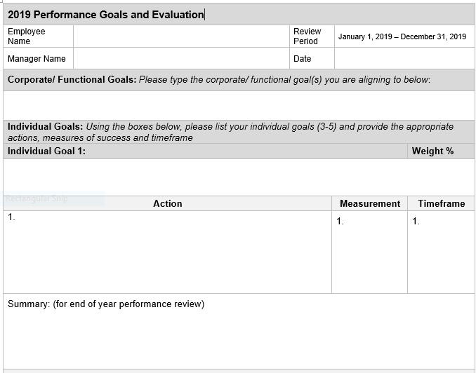
Start with Your Goals
Annual Performance Review Process

Slide 8
Start with Your Goals
Annual Performance Review Process
To copy and paste from your goals document: highlight the text and right click to copy .
When pasting in the table , right click to copy and select the 4th option “Overwrite cells”
Complete your self assessment summary for each of the individual goals you and your supervisor agreed upon

Slide 9
2019 Overall Self – Assessment Sections
Annual Performance Review Process
Complete you self assessment for your overall summary of all the goals you accomplished and how those aligned to the corporate or functional goals

Slide 10
2019 Overall Self – Assessment Sections
Annual Performance Review Process
Complete your self assessment summary for your overall performance . Include any additional accomplishments not captured in your goals summary as well as any behaviors/ values you used to meet your goals
Using Pfenex’s Performance Ratings , please provide your own self assessment

Slide 11
Definitions
Performance Ratings
Performance Rating | Definition
Exceeds requirements | Employee’s performance is outstanding; exceeds expectations of all goals & values
Above requirements | Employee’s performance is excellent; exceeds many expectations of goals & values
Meets requirements | Employee’s performance is good; meets most expectations of goals & values; exceeds some goals and may have room for growth in certain areas
Needs improvement | Employee shows potential but performance is low; Employee does not meet expectations of all goals and requires frequent guidance
Does not meet requirements | Employee’s performance is poor and requires significant improvement immediately

Slide 12
Manager Evaluation
Annual Performance Review Process

Slide 13
Manager Evaluation
Annual Performance Review Process
Provide a summary of how the employee performed against their individuals goals and contribution to the department or corporate goals
Provide an overall summary of how the employee demonstrated Pfenex’s core values through their behaviors and contributions
Provide an overall performance summary. This should include any significant accomplishments made, areas of improvements/ development as well as highlighting any technical strengths
Utilizing Pfenex’s Performance Ratings provide the employees performance rating for the 2018 year

Slide 14
Manager Evaluation (Continued)
Annual Performance Review Process
Once the manager has completed the Performance Evaluation , the second level manager will review and approve
Once the Performance Review is approved, the manager will schedule a Performance Review Discussion
Once the Performance Discussion has occurred both Manager and Employee will sign , date the document and scan it back to Human Resources at hr@Pfenex.com

Slide 15
Writing Effective Reviews
Annual Performance Review Process
Employee
Utilize your 2019 goals document and complete the summary section for each of your individual goals
Make the connection between what you accomplished and how it contributed to the organizations/ department goals
Cite instances where your actions or conduct exemplified Pfenex’s values
Note the challenges you faced and how you handled them.
Be prepared to address areas that you fell short.

Slide 16
Preparing for the Review Discussion
Annual Performance Review Process
Employee
Review your Self-evaluation and identify 2-3 points you want to emphasize
Listen openly to feedback; avoid being defensive
Prepare to discuss how effectively your manager was in supporting your performance and career development
Calibrate your goals and development plans for the new year

Slide 17
Pfenex Leadership Model
Leadership Competencies Addendum
Drive
Growth
Connect & Inspire
Execute

Slide 18
Pfenex Leadership Model
Leadership Competencies Addendum
Drive
Growth
Drive Growth
Proactively drive growth of company and team
Set direction and targets based on vision, ensure all are aligned
Understand the business model and market trends
Think strategically, beyond own function
Champion new ideas and take initiative
Show a relentless drive for innovation, in all areas, big or small
Ensure the availability of the talent to meet current and future needs
Take ownership for talent development
Deal effectively with ambiguity and change
Execute
Drive performance against targets and commitments, ensure completion of projects
Identify and analyze information to make sound decisions and solve problems
Improve work processes to ensure achievement of goals
Demonstrate and foster a sense of urgency and strong commitment to goals
Empower people to act with speed and agility, delegate work and hold accountable
Give permission to take risks and fail fast, apply learnings from failures
Celebrate and reward successes
Connect & Inspire
Articulate and inspire commitment to a plan of action aligned with mission and strategy
Inspire everyone to go the extra mile and be their best
Build high performing inclusive teams
Build trusted partnerships, internal and external
Foster a collaborative environment
Develop and maintain constructive, open and honest relationships with others
Lead courageously to do what is right to achieve success and supports others who do so
Gain the confidence and trust of others through exhibiting company values
Connect & Inspire
Execute
Cultivate insight into:
Self
Others
Business
Notes:
Drive Growth (People and Business)
Understands the business model and market trends
Thinks strategically, beyond own function
Champions new ideas and takes initiative
Ensures the availability of the talent to meet current and future needs
Connect & Inspire
Articulates and inspires commitment to a plan of action aligned with mission and strategy
Develops and maintains constructive, open and honest relationships with others
Leads courageously to do what is right to achieve success and supports others who do so
Gains the confidence and trust of others through exhibiting company values
Execute
Identifies and analyzes information to make decisions and solve problems
Plans, executes and improves work processes to ensure achievement of goals
Demonstrates and fosters a sense of urgency and strong commitment to goals
Deals effectively with ambiguity and change

Slide 19
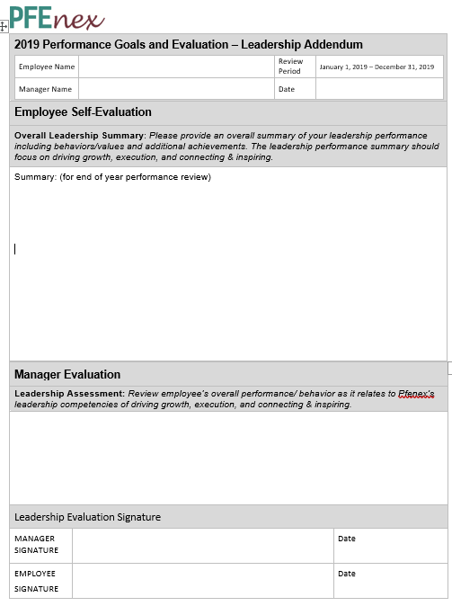
Evaluation Form Addendum - 2019
Leadership Competencies Addendum
A new form to add to the 2019 Goals Evaluation that includes Leadership Self-Evaluation and Manager Leadership Evaluation
For subsequent years after 2019, leadership boxes will be incorporated into evaluation forms
Notes:
Drive Growth (People and Business)
Understands the business model and market trends
Thinks strategically, beyond own function
Champions new ideas and takes initiative
Ensures the availability of the talent to meet current and future needs
Connect & Inspire
Articulates and inspires commitment to a plan of action aligned with mission and strategy
Develops and maintains constructive, open and honest relationships with others
Leads courageously to do what is right to achieve success and supports others who do so
Gains the confidence and trust of others through exhibiting company values
Execute
Identifies and analyzes information to make decisions and solve problems
Plans, executes and improves work processes to ensure achievement of goals
Demonstrates and fosters a sense of urgency and strong commitment to goals
Deals effectively with ambiguity and change

Slide 20
Definitions & Distribution Guidelines
Performance Ratings
Performance Rating | % Guidelines | Definition
Exceeds requirements | 5% | Employee’s performance is outstanding; exceeds expectations of all goals & values
Above requirements | 15% | Employee’s performance is excellent; exceeds many expectations of goals & values
Meets requirements | 70% | Employee’s performance is good; meets most expectations of goals & values; exceeds some goals and may have room for growth in certain areas
Needs improvement | 10% | Employee shows potential but performance is low; Employee does not meet expectations of all goals and requires frequent guidance
Does not meet requirements | 0% | Employee’s performance is poor and requires significant improvement immediately
Notes:
Drive Growth (People and Business)
Understands the business model and market trends
Thinks strategically, beyond own function
Champions new ideas and takes initiative
Ensures the availability of the talent to meet current and future needs
Connect & Inspire
Articulates and inspires commitment to a plan of action aligned with mission and strategy
Develops and maintains constructive, open and honest relationships with others
Leads courageously to do what is right to achieve success and supports others who do so
Gains the confidence and trust of others through exhibiting company values
Execute
Identifies and analyzes information to make decisions and solve problems
Plans, executes and improves work processes to ensure achievement of goals
Demonstrates and fosters a sense of urgency and strong commitment to goals
Deals effectively with ambiguity and change

Slide 21
Writing Effective Reviews
Annual Performance Review Process
Manager
Review key accomplishments relative to established goals and overall impact on the organization.
Be prepared to discuss specific strengths and areas for development as they relate to the Pfenex values. Focus on how goals were achieved.
Be sure to collect cross functional feedback and incorporate this into your evaluation.
Be honest and fair in your ratings.
Notes:
Drive Growth (People and Business)
Understands the business model and market trends
Thinks strategically, beyond own function
Champions new ideas and takes initiative
Ensures the availability of the talent to meet current and future needs
Connect & Inspire
Articulates and inspires commitment to a plan of action aligned with mission and strategy
Develops and maintains constructive, open and honest relationships with others
Leads courageously to do what is right to achieve success and supports others who do so
Gains the confidence and trust of others through exhibiting company values
Execute
Identifies and analyzes information to make decisions and solve problems
Plans, executes and improves work processes to ensure achievement of goals
Demonstrates and fosters a sense of urgency and strong commitment to goals
Deals effectively with ambiguity and change

Slide 22
Preparing for the Review Discussion
Annual Performance Review Process
Manager
Schedule at least 1 hour for the discussion
Review the Performance Review and identify 2- 3 points you want to emphasize
Plan how you will explain the overall rating and reward decisions and anticipate the employee’s questions and concerns
Reflect on the quality of your feedback and coaching throughout the year
Incorporate feedback from the Talent Review process if applicable
Be prepared to discuss performance and development goals for the new year
Notes:
Drive Growth (People and Business)
Understands the business model and market trends
Thinks strategically, beyond own function
Champions new ideas and takes initiative
Ensures the availability of the talent to meet current and future needs
Connect & Inspire
Articulates and inspires commitment to a plan of action aligned with mission and strategy
Develops and maintains constructive, open and honest relationships with others
Leads courageously to do what is right to achieve success and supports others who do so
Gains the confidence and trust of others through exhibiting company values
Execute
Identifies and analyzes information to make decisions and solve problems
Plans, executes and improves work processes to ensure achievement of goals
Demonstrates and fosters a sense of urgency and strong commitment to goals
Deals effectively with ambiguity and change

Slide 23
Timeline
Performance Management
Activity | Date
Performance Review, Self Assessment | December 2 – December 20 ,2019
Performance Review, Manager Assessment | December 20 – January 17, 2020
Performance Ratings submitted | No later than January 8
Performance Review, 2nd level manager review | January 20 – January 24
Compensation Planning | January 13 – January 24
Performance Review/Compensation Discussion | February 3– February 21, 2020

Slide 24
Additional Resources
Annual Performance Review Process
HR Intranet Page contains an overview of the following areas:
Goal Setting and Performance Management Overview
Career Ladders
2019 Corporate Goals
https://in.pfenex.com/pfenex-hr/
HR Support Team :
David Pollak
Chris Roman

Slide 25
Frequently Asked Questions
Annual Performance Review Process
I have had two managers this year. How will my review be handled?
Your current manager is accountable for completing the review and speaking with stakeholders to provide feedback for entire performance period.
How do I evaluate an employee that was not here for the entire year?
Evaluate the employee based on their accomplishments to date. All employees who were hired before 1 October should receive a review.
Why do we have a new evaluation form?
To align with the new goals worksheets implemented in 2019 and to align to our new Pfenex values!

