Slide 1
2020 Goal Setting Overview
January 2020

Slide 2
Agenda
Goal Setting
Performance Management Philosophy
Goal Setting Process
What do Great Goals Look Like
SMART Goals
Goal Form
Timeline

Slide 3
Pfenex’s Philosophy
Goal Setting
Pfenex
- Provides systems, tools and training
Managers
- Set Expectations
- Provide coaching & feedback
Employees
- Strive for excellence
- Take active role in development
Effective performance management aligns the efforts of managers and employees with project and organizational goals, promotes consistency in performance evaluation, motivates all employees to exceed performance expectations, and is conducted with fairness and transparency

Slide 4
Goal Setting Process
Goal Setting
Rollout of Corporate & Functional Goals
Employee Drafts Goals
Goals are Reviewed and Updated Throughout the Year
Employee & Manager Align/Finalize Goals

Slide 5
Performance Management Calendar
Goal Setting
Dec
Jan
Feb
Mar
Apr
May
June
July
Aug
Sep
Nov
Dec
Oct
Employee
Self-Assessment
2nd Level Manager
Review
Merits
and Bonus
Mid-Cycle Performance Discussion
Career Development Month
Employee
Self-Assessment
Performance Review Discussion
Manager Assessment
2019 Goal Setting

Slide 6
What Do Great Goals Look Like?
Goal Setting
Goals should be, at a minimum, SMART. SMART is an acronym that stands for specific, measurable, attainable, relevant, and timely.
Goals should be manageable in number. Three to five meaningful stretch goals are sufficient to challenge and engage in your contribution to the business. Adding more goals is likely to have a negative impact on productivity and derail progress toward achieving any of them.
Goals should address both business results and personal development within the performance year
Goals should be aligned to corporate/functional/project goals Creating organizational line-of-sight allows employees and managers to track progress and adapt their goals to changing needs.

Slide 7
SMART Goals
Goal Setting
S | Specific | The goal clearly defines the outcomes to be delivered with any necessary interpretation agreed upon by the employee and manager in advance.
M | Measurable | The achievement of the goal can be objectively assessed according to a pre-determined and applicable measurement
A | Actionable/Attainable | The goal should stretch the employee and the employee also has the resources, time and access to people, data, etc. to allow him or her to achieve the goal
R | Relevant | The goal addresses work and results that clearly align with the goals of the project, function and organization as a whole.
T | Timely | The goal clearly specifies a delivery date or schedule

Slide 8
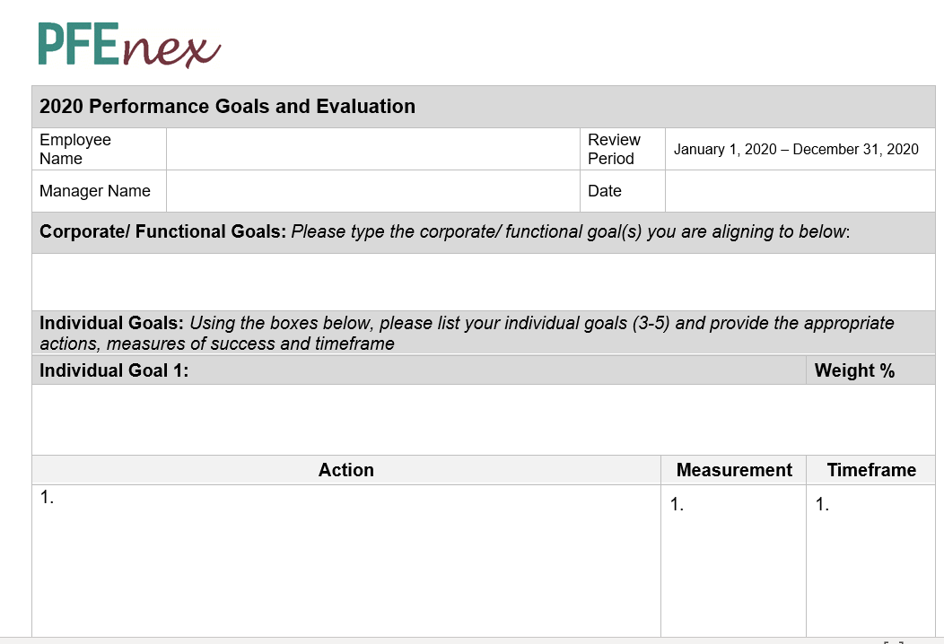
Goal Setting Form
Goal Setting
Align: Type the corporate and/or functional goal that is most Relevant to your individual goal
Goal : Type a Specific goal statement
Action: Type key actions to help Attain your goal
Action: Type your primary Measure that let’s you know that the goal was achieved
Action: Type in the Timing for the completion of the action

Slide 9
Timeline
Goal Setting
Activity | Date
Corporate Goals Rolled Out | 01/22/2020
Goal Setting Training | 01/23/2020
Employees Draft and Send Goals to Manager | 02/14/2020
Employee/Manager Finalize Goals | 02/28/2020
3 Goal Setting Workshops to be scheduled throughout February | To be scheduled

Slide 10
Submitting Goals
Goal Setting
Employee/Manager should meet and finalize goals by end of February
Employee sends PDF of signed goal form to HR@Pfenex.com

Slide 11
Additional Resources
Annual Performance Review Process
HR Intranet Page contains an overview of the following areas:
Goal Setting and Performance Management Overview
Career Ladders
2020 Corporate Goals and Functional Goals
https://in.pfenex.com/pfenex-hr/
HR Support Team :
David Pollak
Chris Roman

Slide 12
DRAFT
2020 Corporate Goals
Goals |  | Max | Target | Min
1. Focus and Execute |  | 37.5% | 25% | 12.5%
1.1 | PF708 US Launch; EU Approval | Q1;Q2 (15%) | Q2;Q3 (10%) | Q3;Q4 (5%)
1.2 | PF745 Collab. Complete.; PF690 Data Package to Jazz | Q2;Q3 (15%) | Q3;Q4 (10%) | Q4;Q1-2021 (5%)
1.3 | CRM197 – Total revenue and Supply Agreements (SA) | $5M + 2 new SA (7.5%) | $4M + 1 new SA (5%) | $3M & 0 SA (2.5%)
2. Expand Selectively |  | 45% | 30% | 15%
2.1 | PF810 Pre-IND Readiness | Pre-IND mtg (22.5%) | pre-IND pkg (15%) | 2nd Species PK (7.5%)
2.2 | New Platform Partnerships | 3 (22.5%) | 2 (15%) | 1 (7.5%)
3. Evolve into Biopharma |  | 45% | 30% | 15%
3.1 | Early Development Program – Lead Molecule Identified | 2 (22.5%) | 1 (15%) | Hits 2 Programs (7.5%)
3.2 | In-license asset to expand portfolio | Q3 (22.5%) | Q4 (15%) | LOI (7.5%)
4. Finances |  | 15% | 10% | 5%
4.1 | Operating Income | > $25M (15%) | >$15M (10%) | >$5M (5%)
5. Engagement and people |  | 7.5% | 5% | 2.5%
5.1 | Improve engagement – Gallup Score | 4.18 (7.5%) | 4.08 (5%) | 3.98 score (2.5%)
 | total | 150% | 100% | 50%

