Slide 1
Rewards and Recognition Program

Slide 2
Overview
Rewards and Recognition
Best Practices
How to create an environment of recognition
Pfenex Awards Programs

Slide 3
Best Practices
Rewards and Recognition
Recognition
Make it timely , frequent , specific, social
Create an environment that facilitates and supports recognition
Tie recognition back to Pfenex values and behaviors
Not all recognition needs to be formal
- The best recognition programs often start organically
Rewards
Get familiar with the new Pfenex Awards Programs
Submit nominations for your peers!

Slide 4
How to help create a culture of rewards and recognition
Rewards and Recognition
Make recognition a formal part of your communication
Recognize your peer, team members during team meetings or in 1:1’s
Look for opportunities to give a “shout out”
Solicit feedback
Informal Recognition is often the most underutilized but most effective
Utilize the recognition toolkits as a starting point
Think of fun, creative ideas that speak to your peers/team (Team mascots, fun trophies, etc)
Make it fun

Slide 5
Pfenex Reward Program
Rewards and Recognition
Program Elements | Service Awards | Spot Award Pfenexian | Hero Award | Values | Teammate
Criteria | 1 year, 5 year, 10 year, 15 year, 20 year, etc. | No changes | Above and beyond – individual contribution, accomplishment | Role modeling behaviors from our values; Consistent behavior (not a 1 off); Can be specific to 1 or more values | Role modeling behavior of teamwork, e.g. encouraging, trustworthy, honest, hardworking, fun, etc.
Eligibility | All employees | No changes | All employees | All employees | All employees
Nomination | N/A | No changes | Peers (all workers) can recognize anyone at anytime | Peers (all employees) submit nominations showing sustained role modeling of our values | Peers (all employees) submit nominations providing at least 3 examples of desired teamwork behaviors
Frequency | Based on start date | No changes | Ongoing | Bi-annual (aligned with mid-year and end of year reviews) | Bi- Annual
Selection | N/A | N/A | Supervisor approval | ELT panel selects winners | ELT panel selects winners
Reward | 1 yr: $100.00 5 yr: $500.00 10 yr: $1,000.00 15yr +: $2,000.00 | $25 gift card | $300.00 | Company Lunch in their honor, name incorporated in mural | $500.00 Company paid lunch (off-site) for honoree plus team

Slide 6
Pfenex Awards Programs
Rewards and Recognition
Submission Process
The HR microsite contains the nomination forms for the Hero Award , Values Awards and the Pfenexian Spot Awards
The Hero and Values awards are awarded on biquarterly basis
The Pfenexian Spot Awards will also be submitted via the nomination form and processed weekly

Slide 7
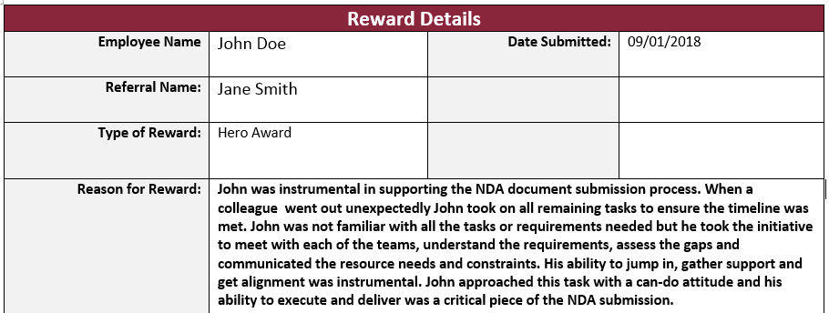
Pfenex Awards Programs
Rewards and Recognition
What to include in the submission forms:
Specifics related to the nominees impact on project, tasks and or team
Include specific related to behaviors and Pfenex values
The more specific you are the better the committee can evaluate the nomination
Submission Form Example:

