Slide 1
Individual Development Plan
and Career Ladder Overview
January 2018

Slide 2
Agenda
Performance Management Philosophy
Keys to Individual Development
Individual Development Plan
How to Write an IDP
Career Ladders
Next Steps

Slide 3
Pfenex’s Philosophy
Employees
- Strive for excellence
- Take active role in development
Pfenex
- Provides systems, tools and training
Managers
- Set Expectations
- Provide coaching & feedback
Effective performance management aligns the efforts of managers and employees with project and organizational goals, promotes consistency in performance evaluation, motivates all employees to exceed performance expectations, and is conducted with fairness and transparency

Slide 4
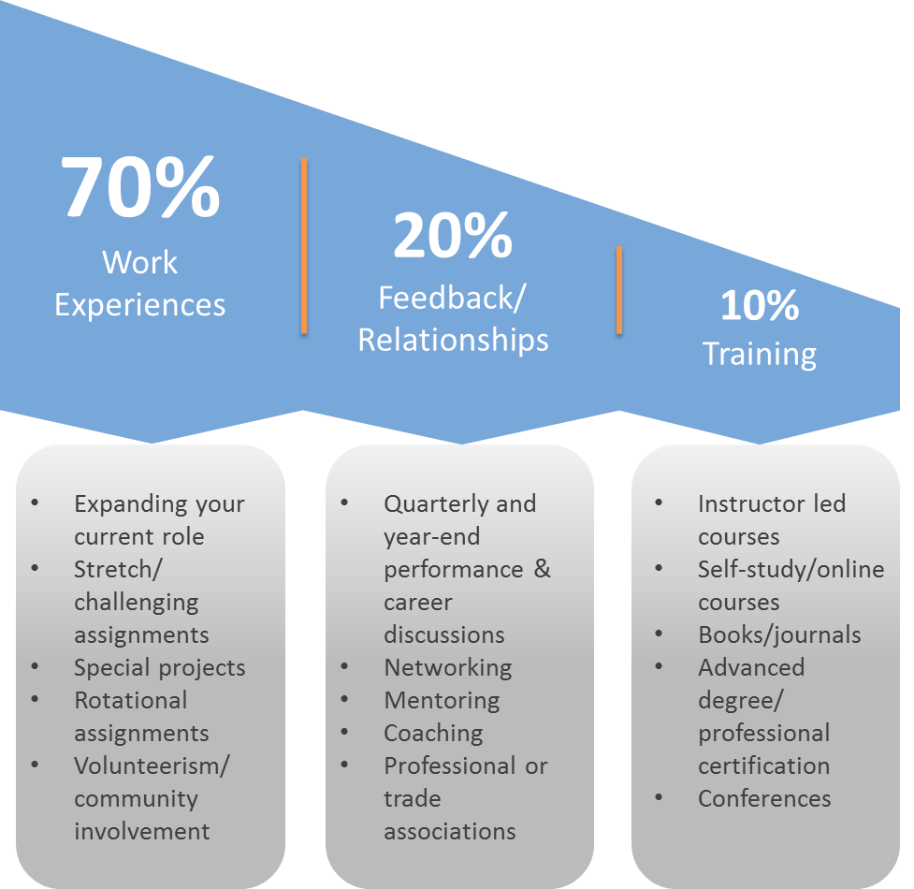

Keys to Individual Development
TAKE ACTION
ASSESS
Employee & Manager
Employee
Manage Your Career
CREATE PLAN
DISCUSS
Notes:
Graphic 1:
ASSESS your strengths and development areas
DISCUSS your goals and aspirations and agree on a plan of action
CREATING A PLAN by completing your Individual Development Plan
TAKE ACTION to complete your development goals.
Graphic 2:
Accelerate your learning by focusing on experience.

Slide 5
What is an Individual Development Plan?
Tool to assist employees in career development
Highlights both short term and long term career aspirations
Living document meant to revised
Partnership between manager and employee around development opportunities/ goals
Not a performance evaluation

Slide 6
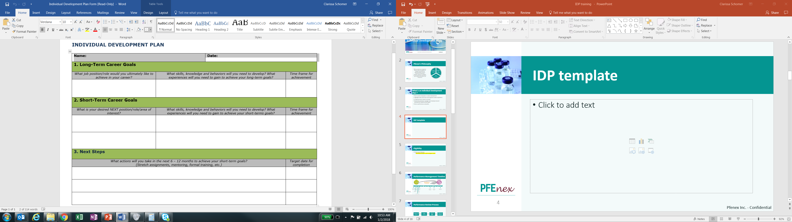
IDP Template

Slide 7
How to Write an IDP
Define your short term and long term career goals
  What skills, behaviors or knowledge , do you need to develop
  Think about projects, hands on experience, stretch assignment
Prioritize
Set realistic deadlines
Understand your strengths and opportunities
Be prepared to discuss your plan with your manager
Take action

Slide 8
IDP Process
Discuss the plan with your manager
Assess Progress
Revise and Adjust
Prepare your IDP

Slide 9
Frequently Asked Questions
What is a development goal?
- Development goals address employee knowledge/skill gaps, are aligned with individual career aspirations, and generally have a long term focus
I have a role in mind but am unsure of the skills required
- Be prepared to have the discussion with your manager. If the role falls outside your current department, human resources can provide you with a job description. In addition, feel free to network with your colleagues.
Will my performance be evaluated against my IDP goals?
- No, performance reviews and IDP’s are two separate items. Your IDP is meant to be your own personal guide for your career aspirations. You may want to include items from your IDP as part of your own development plans for the upcoming year.

Slide 10
Development Goals versus Performance Goals
Performance Goals
Job Oriented
Short term objectives within the performance cycle
Results based
Include day to day responsibilities, cover your job scope
They tie back to the overall company or department goals
Development Goals
Learning Oriented
Include skills, knowledge and experience needed to remain effective in role long term or to support the ability to take on new responsibilities
Address future state career objectives

Slide 11
Career Ladders

Slide 12
Agenda
Benefits of career ladder
Job leveling methodology
Additional benefits
Career ladder dimensions
Career Ladders
Next Steps

Slide 13
Benefits of Career Ladders
Groups jobs into career paths
Establish Levels Within Each Path
Provides consistent framework for categorizing job families as we grow
Jobs
Paths
Levels
Finance
Manager
Financial
Analyst
Level 6
Expert in Field
Management
Level 5
Broad Expertise
HR
Partner
Associate
Recruiter
Trainer
Professional
Level 4
Advanced
Research
Associate
Scientist
VP
Prod Dev
Level 3
Career
Operations & Support
Level 2
Developing
Program
Director
Principal
Software
Engineer
Project
Manager
Level 1
Learning

Slide 14
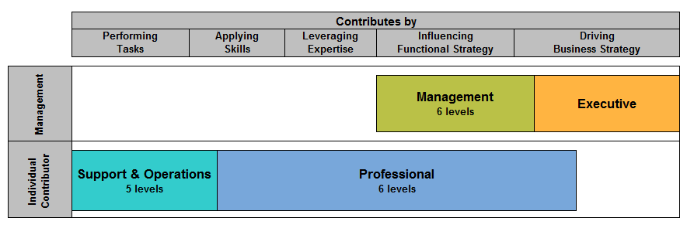
Job Leveling Methodology
Jobs organized into broad categories based on method of contribution to Pfenex and major attributes to create Job Leveling Guidelines
Leveling guidelines focus on scope, job complexity, expertise, problem solving, interaction, and supervision, etc.

Slide 15
Career Ladder Job Dimension
Knowledge
Application of Professional Concepts
Job Complexity
Narrow or Broad Scope
Supervision
Level of Autonomy
Impact of Judgement or Decisions
Level of Expertise
Job Scope
Range of activities, duties or responsibilities expected for job
Level of impact role has on organization

Slide 16
Other Benefits of Job Levels
Total Rewards
Training &
Development
Total Rewards
Career
Planning
Training &
Development
Career
Planning
Workforce
Planning
Creating
Job Descriptions
Recruiting

Slide 17
Scientific Management Track Career Ladder
Job Dimensions: | Manager | Group Lead | Associate Director | Director | Senior Director
Analogy | Escorts hikers on day trips (Routine situations, emergency prepared) | Guides team while rock climbing (Skills/training needed, risk-taking support systems in place) | Leads extended alpine mountain-climbing trips (Experienced leadership required for multi-faceted environment) | Controls search efforts to find missing hikers (Strategic battle-tested leader, directs operational units) | Directs efforts of both air and ground search parties (Inspires action, coordinates simultaneous initiatives)
Scope | Receives predetermined work assignments that are subject to a moderate level of control and review. Directs subordinates to complete assignments using established guidelines, procedures and policies. | Receives assignments in the form of objectives and determines how to use resources to meet schedules and goals. Provides guidance to subordinates within the latitude of established company policies. Recommends changes to policies and establishes procedures that affect immediate organization(s). | Establishes operational objectives and work plans and delegates assignments to subordinates. Senior management reviews objectives to determine success of operation. Involved in developing, modifying and executing company policies that affect immediate operations and may also have company-wide effect. | Participates with other senior managers to establish strategic plans and objectives. Makes final decisions on administrative or operational matters and ensures operations are effective for achievement of objectives. | Develops corporate and/or organizational policies and authorizes their implementation. Detailed knowledge of company allows for innovative concepts and promoting new ideas. Provides direction to senior managers in various areas, groups, and/or operations. Recognized as an influential leader.
Complexity | Works on issues of limited scope. Follows established practices and procedures in analyzing situations or data from which answers can be readily obtained. Monitors daily operations of a unit or sub-unit. Requires full knowledge within the area of functional responsibility. | Works on issues of diverse scope where analysis of situation or data requires evaluation of a variety of factors, including an understanding of current business trends. Follows processes and operational policies in selecting methods and techniques for obtaining solutions. Acts as advisor to subordinate(s) to meet schedules and/or resolve technical problems. Develops and administers schedules, performance requirements; may have budget responsibilities. | Works on issues where analysis of situations or data requires an in-depth knowledge of organizational objectives. Implements strategic policies when selecting methods, techniques, and evaluation criteria for obtaining results. Establishes and assures adherence to budgets, schedules, work plans, and performance requirements. | Works on complex issues where analysis of situations or data requires an in-depth knowledge of the company. Participates in corporate development of methods, techniques and evaluation criteria for projects, programs, and people. Ensures budgets and schedules meet corporate requirements. | Consistently works with abstract ideas or situations across functional areas of the business. Through assessment of intangible variables, identifies and evaluates fundamental issues, providing strategy and direction for major functional areas. Requires in-depth knowledge of the functional area, business strategies, and company goals.
Discretion | Erroneous decisions or failure to achieve results may cause delays in schedules. | Erroneous decisions or failure to achieve results will add to costs and may impact the short-term goals of the organization. | Erroneous decisions will result in critical delay(s) in schedules and/or unit operations and may jeopardize overall business activities. | Erroneous decisions will have a serious impact on the overall success of functional, division, or company operations. | Erroneous decisions will have a long-term effect on the company's success.
Interaction | Interacts daily with subordinates and/or functional peer groups. Interaction normally involves exchange or presentation of factual information. | Frequently interacts with subordinate supervisors, customers, and/or functional peer group managers, normally involving matters between functional areas, other company divisions or units, or customers and the company. Often must lead a cooperative effort among members of a project team. | Regularly interacts with senior management or executive levels on matters concerning several functional areas, divisions, and/or customers. Requires the ability to change the thinking of, or gain acceptance from, others in sensitive situations, without damage to the relationship. | Regularly interacts with executives and/or major customers. Interactions frequently involve special skills, such as negotiating with customers or management or attempting to influence senior level leaders regarding matters of significance to the organization. | Interacts internally and externally with executive level management, requiring negotiation of extremely critical matters. Influences policymaking.
Supervision | Provides immediate supervision to an employee or small team, assigning tasks, checking work at frequent intervals, and maintaining schedules. A portion of time is normally spent performing individual tasks related to the unit or sub-unit. Generally supervises semi-skilled employees (e.g., assemblers, operators, clerical). | Manages the coordination of the activities of a section or department with responsibility for results. In some instances this manager may be responsible for a functional area and not have any subordinate employees. | Directs and controls the activities of a functional area through several department managers within the company. Has overall control of planning, staffing, budgeting, managing expense priorities, and recommending and implementing changes to methods. | Directs and controls the activities of a functional area through several department managers within the company. Has overall control of planning, staffing, budgeting, managing expense priorities, and recommending and implementing changes to methods. | Directs and controls the activities of one or more functional areas, divisions, product groups or service areas through managers who have overall responsibility for the successful operation of those assigned areas.

Slide 18
Scientific Track Career Ladder
Job Dimensions: | Technician | Associate Scientist I | Associate Scientist II | Scientist | Senior Scientist (Career Level) | Principal Scientist
Analogy | Learns about rope and how to tie basic knots | Can tie basic knots Shown complex knots | Calculates rope strength Knows a lot about knots | Understands rope making | Knows more about rope than you ever will | Invented nylon
Job Level | Applies acquired job skills and company policies and procedures to complete assigned tasks. | Obtaining professional expertise, beginning to apply expertise and company policies and procedures to resolve technical problems. | Developing professional expertise, applies expertise and company policies and procedures to resolve a variety of issues and technical problems. | Uses professional concepts aligning with company policies and procedures to solve a wide range of difficult problems in imaginative and practical ways. | Uses professional concepts in accordance with company objectives to solve complex problems in creative and effective ways. Note: This is the career level. | Demonstrates expertise in the application of scientific principles, theory and experimental design. Demonstrates expert knowledge of the industry and marketplace, and uses this knowledge to implement projects and strategies. Note: This level parallels management level 3 on the career ladder.
Job scope | Uses acquired job skills to support scientific staff and lab operations. Works independently to complete assigned tasks | Learning the technologies in the functional area. Building network with technical experts. Contributes to procedures and reports. | Understands the technologies and application in the functional area. Can articulate the limitations and benefits of their technology to others. Establishes network with technical experts. Authors procedures and contributes to reports. | Demonstrates knowledge of a subject matter expert (SME) in the functional area, authors technical reports, and is able to provide technical guidance on multiple projects. Mentors Associate Scientists and Technicians, and trains junior staff in routine development policies and trouble shooting of existing procedures. | As a subject matter expert (SME) in the functional area, authors technical and regulatory documents, and represents the functional area on cross functional teams. Mentors Scientists and Associate Scientists, and trains junior staff in development and trouble shooting new procedures within the broader scope of program development. | Demonstrates an in-depth knowledge of the cross-functional processes, policies and resources, and their impact on the Company. Demonstrates the ability to deal with unknowns, and advocates courses of action based on data that are often incomplete.
Job Complexity | Works on assignments that are semi-routine in nature but recognizes the need for occasional deviation from accepted practice. | Works on problems of limited scope. Follows standard practices and procedures in analyzing situations or data from which answers can be readily obtained. | Works on problems of moderate scope where analysis of situations or data requires a review of a variety of factors. Independently exercises judgment within defined procedures and practices to determine appropriate action. Builds productive internal/external working relationships. | Demonstrated success in technical proficiency, collaboration with others and independent work. Can anticipate technical project needs and propose alternate solutions to mitigate risk. Works through complex problems and data evaluation with some coaching. Exercises judgment within defined practices and policies in selecting methods, techniques and evaluation criteria for obtaining results. | Demonstrated success in technical proficiency, scientific creativity, collaboration with others and independent thought. Can anticipate project technical needs and identify new technology to mitigate risk. Works on complex problems in which analysis of situations or data requires an in-depth evaluation of various factors. Exercises judgment within broadly defined practices and policies in selecting methods, techniques and evaluation criteria for obtaining results. Identifies and captures intellectual property | Demonstrated success in technical proficiency, scientific creativity, collaboration with others and independent thought. Works on extremely complex problems in which analysis of situations or data requires an evaluation of intangible variables. Exercises independent judgment in developing methods, techniques and evaluation criteria for obtaining results. May identify and develop new technologies and capabilities for the company. Demonstrates knowledge of applicable business and regulatory issues and processes.

Slide 19
Scientific Track Career Ladder (cont)
Job Dimensions: | Technician | Associate Scientist I | Associate Scientist II | Scientist | Senior Scientist (Career Level) | Principal Scientist
Supervision | Normally follows established procedures on routine work, requires instructions only on new assignments. | Normally receives detailed instructions on all work. | Normally receives general instructions on routine work, and detailed instructions on new assignments. | Normally receives no instructions on routine work, and general instructions on new assignments. Receives some assistance in the development of new procedures or new technologies. | Determines methods and procedures on new assignments and provides guidance to junior staff members. | Acts independently to determine methods and procedures on new assignments. May oversee and manage the activities of junior staff- primary role is an individual contributor.
Communication/ Interpersonal skills/ Influence | Proactively seeks feedback from laboratory personnel to understand experimental needs. Communicates laboratory/ equipment needs to supervisor ensuring smooth operation of experiments. | Builds relationships with team members. Developing effective verbal and written communication skills by effectively assimilating feedback from more senior level scientists and managers | Provides clear and concise technical reports, emails, and presentations with some coaching. Receives feedback and is able to incorporate into revised communications in a timely fashion. Works well in a team environment. | Provides clear and concise technical reports, emails, and presentations with some coaching. Receives feedback and is able to incorporate into revised communications in a timely fashion. Works well in a team environment, and is able to motivate junior members to reach project objectives. | Consistently provides clear, concise technical reports, emails and presentations with few errors. Demonstrated ability to listen to others' responses and feedback to adjust content of communications appropriately. Is able to represent the company externally in their technical area | Is viewed as the technical SME from outside the company. Understands the organization and is able to represent the company to external collaborators. Consistently provides clear, concise technical reports, emails and presentations with few errors. Demonstrated ability to listen to others' responses and feedback to adjust content of communications appropriately, particularly in communication with senior management
Leadership | Demonstrated independence to perform routine work. | Is a contributing team member and can independently execute a well defined project. | Is a contributing team member and can lead a small technical sub team of a larger well defined project. | Is recognized as a technical leader in the functional area. Able to provide clear directions and set expectations for junior members of the team; beginning cross functional leadership. Coordinates with other functional departments to meet project timelines. | Mentors junior staff. Shows demonstrated cross functional leadership skills with an ability to communicate clear project goals and expectations. Able to lead projects by defining scope and deliverables across functional areas. | Creates an innovation-friendly workplace by taking risks, bringing in novel ideas and technologies, and leveraging learnings from other functions, businesses, and the external scientific community. Understands what capability needs the organization has, and anticipates future needs. Is a key resource for selecting and developing scientific talent.

Slide 20
Non R&D Management Career Ladder
Job Dimensions: | Supervisor | Manager | Senior Manager | Associate Director | Director | Senior Director
Scope | Receives predetermined work assignments that are subject to a moderate level of control and review. Directs subordinates to complete assignments using established guidelines, procedures and policies. | Receives assignments in the form of objectives and determines how to use resources to meet schedules and goals. Provides guidance to subordinates within the latitude of established company policies. Recommends changes to policies and establishes procedures that affect immediate organization(s). | Leads operational objectives and work plans and delegates assignments to subordinates. Senior management reviews objectives to determine success of operation. Involved in developing, modifying and executing company policies that affect immediate operations and may also have company-wide effect. | Establishes operational objectives and work plans and delegates assignments to subordinates. Senior management reviews objectives to determine success of operation. Involved in developing, modifying and executing company policies that affect immediate operations and may also have company-wide effect. | Participates with other senior managers to establish strategic plans and objectives. Makes final decisions on administrative or operational matters and ensures operations effective achievement of objectives. | Develops corporate and/or organizational policies and authorizes their implementation. Detailed knowledge of company allows for innovative concepts and promoting new ideas. Provides direction to senior managers in various areas, groups, and/or operations. Recognized as an influential leader.
Complexity | Works on issues of limited scope. Follows established practices and procedures in analyzing situations or data from which answers can be readily obtained. Monitors daily operations of a unit or sub-unit. Requires full knowledge of own area of functional responsibility. | Works on issues of diverse scope where analysis of situation or data requires evaluation of a variety of factors, including an understanding of current business trends. Follows processes and operational policies in selecting methods and techniques for obtaining solutions. Acts as advisor to subordinate(s) to meet schedules and/or resolve technical problems. Develops and administers schedules, performance requirements; may have budget responsibilities. | Works on issues where analysis of situations or data requires broad knowledge of organizational objectives. Implements strategic policies when selecting methods, techniques, and evaluation criteria for obtaining results. Assures adherence to budgets, schedules, work plans, and performance requirements. | Works on issues where analysis of situations or data requires an in-depth knowledge of organizational objectives. Implements strategic policies when selecting methods, techniques, and evaluation criteria for obtaining results. Establishes and assures adherence to budgets, schedules, work plans, and performance requirements. | Works on complex issues where analysis of situations or data requires an in-depth knowledge of the company. Participates in corporate development of methods, techniques and evaluation criteria for projects, programs, and people. Ensures budgets and schedules meet corporate requirements. | Consistently works with abstract ideas or situations across functional areas of the business. Through assessment of intangible variables, identifies and evaluates fundamental issues, providing strategy and direction for major functional areas. Requires in-depth knowledge of the functional area, business strategies, and the company’s goals.
Discretion | Erroneous decisions or failure to achieve results may cause delays in schedules. | Erroneous decisions or failure to achieve results will add to costs and may impact the short-term goals of the organization. | Erroneous decisions will result in critical delay(s) in schedules and/or unit operations. | Erroneous decisions will result in critical delay(s) in schedules and/or unit operations and may jeopardize overall business activities. | Erroneous decisions will have a serious impact on the overall success of functional, division, or company operations. | Erroneous decisions will have a long-term effect on the company's success.
Interaction | Interacts daily with subordinates and/or functional peer groups. Interaction normally involves exchange or presentation of factual information. | Frequently interacts with subordinate supervisors, customers, and/or functional peer group managers, normally involving matters between functional areas, other company divisions or units, or customers and the company. Often must lead a cooperative effort among members of a project team. | Regularly interacts with senior management on matters concerning individual functional areas. Requires the ability to change the thinking of, or gain acceptance from, others in sensitive situations, without damage to the relationship. | Regularly interacts with senior management or executive levels on matters concerning several functional areas, divisions, and/or customers. Requires the ability to change the thinking of, or gain acceptance from, others in sensitive situations, without damage to the relationship. | Regularly interacts with executives and/or major customers. Interactions frequently involve special skills, such as negotiating with customers or management or attempting to influence senior level leaders regarding matters of significance to the organization. | Interacts internally and externally with executive level management, requiring negotiation of extremely critical matters. Influences policymaking.
Supervision | Provides immediate supervision to a unit or group of employees, assigning tasks, checking work at frequent intervals, and maintaining schedules. A portion of time is normally spent performing individual tasks related to the unit or sub-unit. Generally supervises semi-skilled employees (e.g., assemblers, operators, clerical). | Manages, perhaps through subordinate supervisors, the coordination of the activities of a section or department with responsibility for results, including costs, methods and staffing. In some instances this manager may be responsible for a functional area and not have any subordinate employees. | Manages activities of one departments. Exercises supervision in terms of costs, methods, and staffing. | Manages activities of two or more sections or departments. Exercises supervision in terms of costs, methods, and staffing.In some instances this manager may have subordinate supervisors. | Directs and controls the activities of a broad functional area within the company. Has overall control of planning, staffing, budgeting, managing expense priorities, and recommending and implementing changes to methods. | Directs and controls the activities of one or more functional areas, divisions, product groups or service areas through senior managers who have overall responsibility for the successful operation of those assigned areas.

Slide 21
Professional Career Ladder
Job Dimensions: | Entry | Developing | Career | Advanced | Expert | Principal
Job Level | Learns to use professional concepts. Applies company policies and procedures to resolve routine issues. | Developing professional expertise, applies company policies and procedures to resolve a variety of issues. | A seasoned, experienced professional with a full understanding of area of specialization; resolves a wide range of issues in creative ways. This job is the fully qualified, career-oriented, journey-level position. | Having wide-ranging experience, uses professional concepts and company objectives to resolve complex issues in creative and effective ways. Some barriers to entry exist at this level (e.g., dept/peer review). | Having broad expertise or unique knowledge, uses skills to contribute to development of company objectives and principles and to achieve goals in creative and effective ways. Barriers to entry such as technical committee review exist at this level. | As an expert in the field, uses professional concepts in developing resolution to critical issues and broad design matters. Significant barriers to entry (e.g., top management review, approval) exist at this level.
Job Complexity | Works on problems of limited scope. Follows standard practices and procedures in analyzing situations or data from which answers can be readily obtained. Builds stable working relationships internally. | Works on problems of moderate scope where analysis of situations or data requires a review of a variety of factors. Exercises judgment within defined procedures and practices to determine appropriate action. Builds productive internal/external working relationships. | Works on problems of diverse scope where analysis of data requires evaluation of identifiable factors. Demonstrates good judgment in selecting methods and techniques for obtaining solutions. Networks with senior internal and external personnel in own area of expertise. | Works on complex issues where analysis of situations or data requires an in-depth evaluation of variable factors. Exercises judgment in selecting methods, techniques and evaluation criteria for obtaining results. Networks with key contacts outside own area of expertise. | Works on significant and unique issues where analysis of situations or data requires an evaluation of intangibles. Exercises independent judgment in methods, techniques and evaluation criteria for obtaining results. Creates formal networks involving coordination among groups. | Works on issues that impact design/selling success or address future concepts, products or technologies. Creates formal networks with key decision makers and serves as external spokesperson for the organization.
Supervision | Normally receives detailed instructions on all work. | Normally receives general instructions on routine work, detailed instructions on new projects or assignments. | Normally receives little instruction on day-to-day work, general instructions on new assignments. | Determines methods and procedures on new assignments and may coordinate activities of other personnel (Team Lead). | Acts independently to determine methods and procedures on new or special assignments. May supervise the activities of others. | Exercises wide latitude in determining objectives and approaches to critical assignments.

Slide 22
Support & Technician Career Path
Job Dimensions: | Entry | Intermediate | Senior | Highly Skilled | Specialist
Job Level | Acquires job skills and learns company policies and procedures to complete routine tasks. | Applies acquired job skills and company policies and procedures to complete assigned tasks. | Has substantial understanding of the job and applies knowledge and skills to complete a wide range of tasks. | As a skilled specialist, completes tasks in resourceful and effective ways. | As a highly skilled specialist, contributes to the development of concepts and techniques. Completes complex tasks in creative and effective ways.
Job Complexity | Works on assignments that are routine in nature, requiring limited judgment. Has little or no role in decision-making. | Works on assignments that are semi-routine in nature but recognizes the need for occasional deviation from accepted practice. | Works on assignments that are moderately difficult, requiring judgment in resolving issues or in making recommendations. | Works on assignments requiring considerable judgment and initiative. Understands implications of work and makes recommendations for solutions. | Consistently works on complex assignments requiring independent action and a high degree of initiative to resolve issues. Makes recommendations for new procedures.
Supervision | Normally receives detailed instructions on all work. Works under close supervision. | Normally follows established procedures on routine work, requires instructions only on new assignments. | Normally receives little instruction on daily work, general instructions on newly introduced assignments. | Determines methods and procedures on new assignments. May be informal team leader. | Acts independently to determine methods and procedures on new assignments. Often acts as a facilitator and team leader.

Slide 23
Next Steps
Begin drafting IDP
Review IDP with your manager
Complete IDP

Slide 24
INNOVATIVE SOLUTIONS FOR GLOBAL HEALTH
© 2017 Pfenex Inc. All rights reserved.

