Slide 1
Pfenex Onboarding

Slide 2
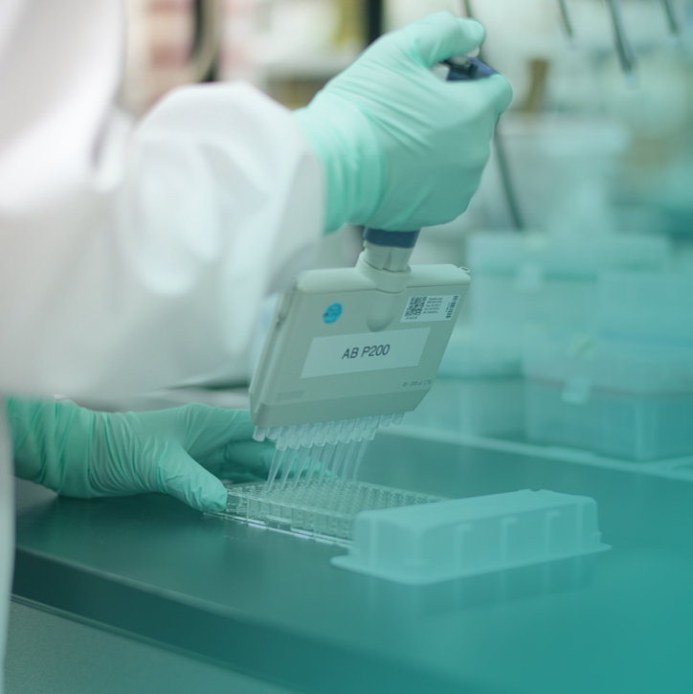

Agenda
Pfenex Onboarding
Company Overview
Platform Overview
Pipeline Overview
Functional Overviews
Paperwork

Slide 3
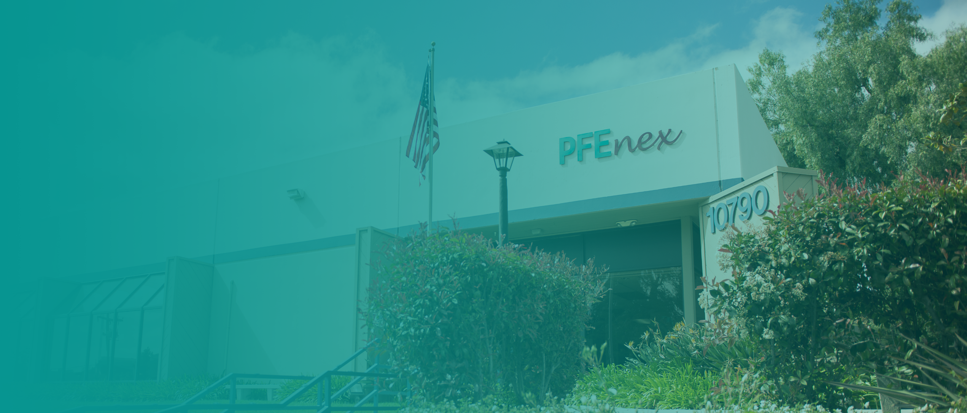
Pfenex Company Background
Pfenex is a biotechnology company, founded in 2009, focused on the development of complex proteins, biosimilars, therapeutic equivalents and vaccines using our unique, patented Pfenex Expression Technology™ platform
Extensive competencies from early research and design to regulatory filing and partnership management
85+ FTE, San Diego-based, listed on NYSE American: PFNX

Slide 4



Company Overview
Pfenex is a development and licensing biotechnology company leveraging its Pfenex Expression Technology®
platform to develop and commercialize improved protein therapies for unmet patient needs
Validated Platform Clinically and regulatory validated platform with FDA-approved product
Advanced Pipeline
Products nearing commercialization and clinical stage biopharmaceutical products
Potential Near-term
Milestones
PF708
Jazz
CRM197
U.S. launch by Alvogen expected upon FDA decision on TE rating
PF743/JZP-458 BLA filing expected as early as Q4 2020
Merck V114 BLA filing expected as early as Q4 2020
SIIPL in launch preparation for Pneumosil®
Growth Strategy
Expanding our pipeline with a combination of wholly owned products and new royalty bearing
collaborations, as well as exploring novel biopharmaceutical opportunities
$
Cash and Shares
Outstanding
Cash position of $56M and 32.3M shares outstanding (as of 12/31/2019). Excludes $19M of net cash proceeds from the sale of approximately 1.8M shares in Q1 2020
4

Slide 5


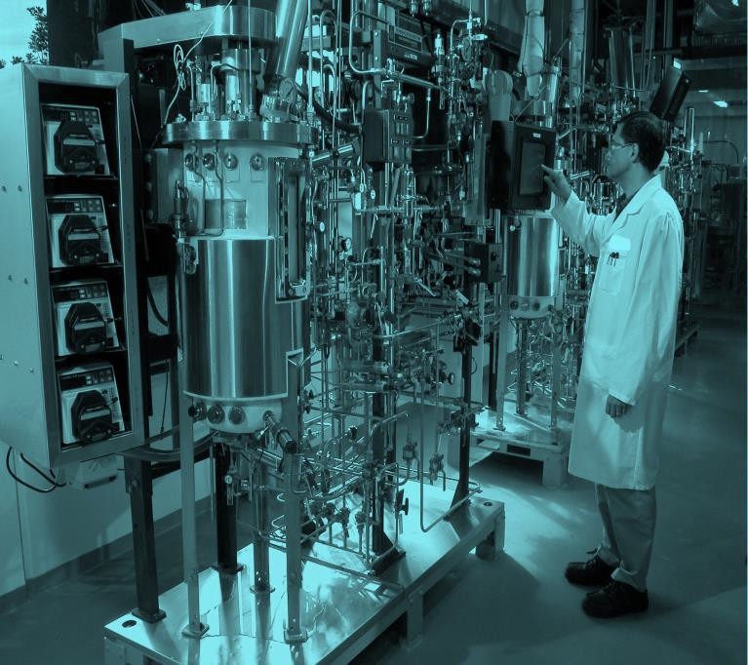
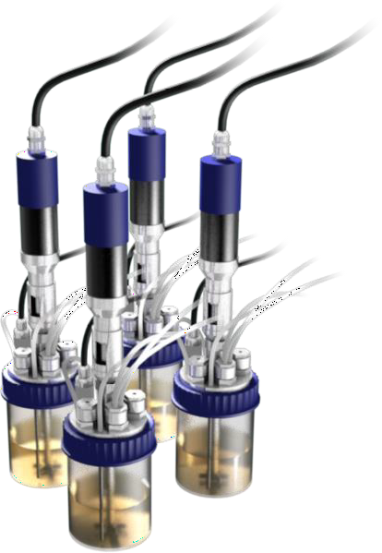
Pfenex Expression Technology® Platform
Discovery and development of biopharmaceutical proteins
1
Engineer 1,000’s of Strains
2
Rapid Screening
3
Scale-Up and Production
Pfenex leveraged bioinformatics and transcriptomics to develop an extensive toolbox of expression strains and plasmids
High throughput screening enables production strains to be screened for titer, solubility, and activity prior to scale-up
Targeted process optimization and state of the art analytical capabilities deliver commercial manufacturing strain
5

Slide 6
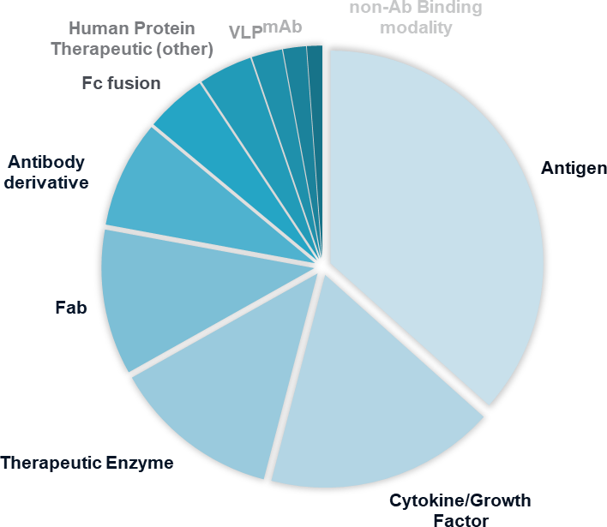
Proprietary Platform
Our platform is uniquely enabling for next generation modalities
Regulatory and clinically validated
  PF708 FDA-approved and our partners’ programs nearing commercialization (Jazz, Merck and SIIPL)
Deep institutional knowledge
  60+ collaborations, most of top 15 pharma companies
  success rate* >80% expressing >170 “lead”
proteins.
Broad platform and product IP portfolio
  24 issued U.S. patents as of Dec 2019.
Proprietary platform and seasoned team
  enables development of novel therapeutics leveraging broad range of next-generation modalities
Distribution of >170 successfully expressed
“lead” protein classes
*Success is defined as high titer of properly folded protein
6

Slide 7

















Product Pipeline
Preclin | P1 | P2 | P3 | Reg | Comm | Partner
PF708
Teriparatide – Osteoporosis
EU/RoW
US
PF743 (JZP-458)
Recombinant Erwinia asparaginase
PF745 (JZP-341)
Long-acting Recombinant Erwinia asparaginase
CRM197
Carrier Protein
Add’l Progs.
Meningococcal Vaccine
Pneumosil
Add’l Progs.
V114
Various undisclosed partnerships
PF810
Recombinant peptide
PF753, PF754
Arcellx ARC-T – SparX
PF91X
Various Targets In Screening

Slide 8












Pfenex Overview
Leadership Team
Eef Schimmelpennink
Chief Executive Officer
Chief Financial Officer
Patrick Lucy
Chief Business Officer
Shawn Scranton
Chief Operating Officer
David Pollak
Senior Director, Human Resources
Martin Brenner
Chief Scientific Officer
Senior
Management
Board
of Directors
Jason Grenfell-Gardner
Robin Campbell
Philip Schneider
Lorianne Masuoka
John Taylor
Magda Marquet

Slide 9
Pfenex’s Organizational Structure
Pfenex Overview
CEO
Chief Operating Officer
Product Development Leaders
Business Development
CFO Organization
Accounting
FP&A
Human Resources
Information Technology
Business Development
Product Marketing, Marketing, Communications
Chief Scientific Officer
Analytical Development
Purification Development & Lab Operations
Platform Technology & Innovation
Purchasing and Operations
Tech Transfer
Device
Facilities
Regulatory
Quality
Payroll
Drug Discovery

Slide 10
Function Overview I

Slide 11
Facilities Operations & Eng’g Dept.
Function Overview
General Inquiries
  Facilities general information and or questions, email facilities@pfenex.com
  Physical Security general information and or questions, email security@pfenex.com
Facilities Technical Support
  Juan Estupinan – Facilities & Lab Equipment Technician jestupinan@pfenex.com
Physical Security
  Refer to SOP-9033 for Facilities Physical Security policy*
    To acquire a temporary badge, see one of the facilities team member.
    Temp Badge is only good for 24 hours
  Refer to SOP-0259 for Security Access Card Procedure policy*
  All visitors must check-in at the lobby via sign-in system and must be accompanied at all times. Badge must be worn at all times during the visit and must check out prior to leaving the site. Badge label is provided by the sign-in system.
*All related SOP will be presented during your orientation by QA Dept.

Slide 12
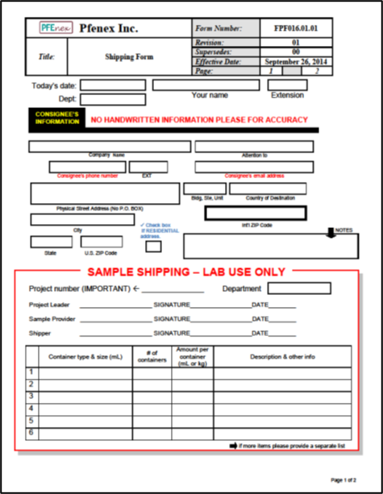
Facilities Operations & Eng’g Dept.
Function Overview
Shipping & Receiving
  Tim Salmon – Coordinator tsalmon@pfenex,.com
  General inquiry shipping@pfenex.com
  All outgoing standard shipment must be accompanied by a filled Shipping Form re: FPF016.01.01

Slide 13
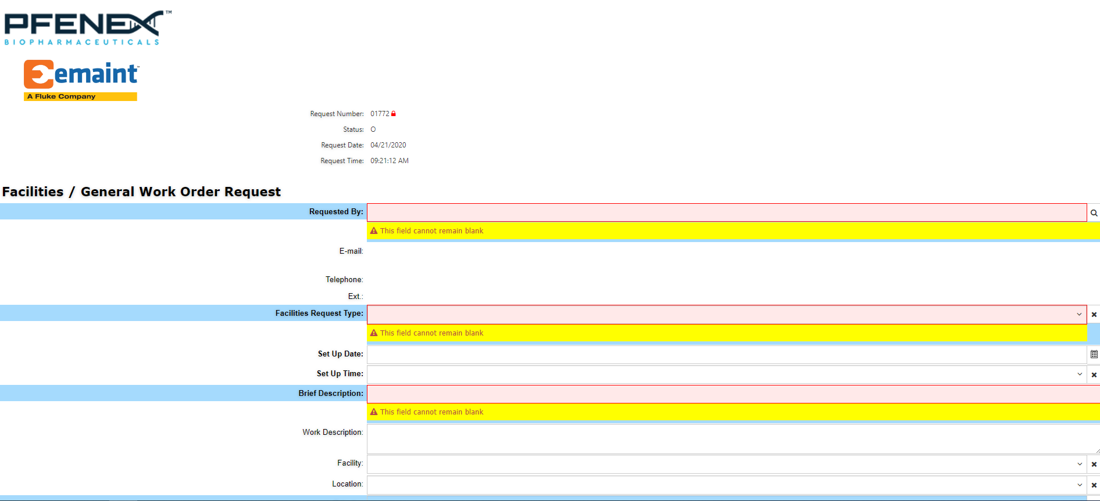
Facilities Operations & Eng’g Dept.
Function Overview
Work Order Request
  To access work order system https://in.pfenex.com/
  Select FACILITIES WORK REQUEST
  Fill form then click “Save New Record” on the upper left corner to submit request.
  24 hour turnaround for approval

Slide 14
Information Technology (IT)
Function Overview
Corporate Password Policy
  Must be 10 characters or more
  Must contain a combination of capital, lower case letter, also contain a number and/or a special character
  Passwords expire every 90 days
VPN
  Full Name (example: John Smith)
  Computer login password
  VPN is needed to access the Share Drive, Time and Expense, and CostPoint.
Office 365 Suite Overview
Web mail/SharePoint
  Https://Portal.Office.com
HelpDesk: IT Ticket System & Facilities Ticket System
  Helpdesk@Pfenex.com Security@Pfenex.com

Slide 15

Information Technology (IT)
Function Overview
Share Drive (S:\)
  \\Main\shares
Back up System
  Crashplan (Code42) – local user directory.
  (ex: documents, downloads, etc.)
  Backup runs continuously as long as you are online.
Wireless networks
  Pfenex-Internal: IT maintains password
  Pfenex Guest: PFNX10790
  Cellphones, personal computer, tablets, etc., can join the
  guest network
Desk phone
  Directory (S:\Project\!San_Diego_all\PhoneList)
  Dial 9 to call outside of company

Slide 16

Information Technology (IT)
Function Overview
Printer Overview
  Printer location(s)
  Scan to email
  Secure print
Questions?
  Trouble tickets: Helpdesk@Pfenex.com
  Email: Helpdesk@pfenex.com
  Urgent HelpDesk Issues: ext.223

Slide 17
Safety
Function Overview
Providing a safe work environment is a primary concern at Pfenex. Everyone is responsible for safety, and must be dedicated to conducting all activities with the highest concern for employee health and safety.
We take an active role in ensuring everyone remains safe, and therefore have several required safety training sessions / events scheduled throughout the year.
Initial Safety Tasks To Do:
  All Personnel
    Safety Introduction and Lab Tour (HR has scheduled this already)
    Review the Site Emergency Plan and Quiz (Slides provided by HR)
Lab Personnel
  Checklist of Lab Safety Tasks (Initiated with your assigned Safety Action Committee [SAC] Member)
  As needed, request personalized safety equipment (Approval Forms for Glasses & Shoes)
Safety Resources:
  Safety Folder – Contains site safety information and policies
  Pfenex Emergency Guide – Contains detailed “What To Do” information in event of an emergency

Slide 18
Safety
Function Overview
Critical Safety Actions and Procedures:
  Major Emergency
    Evacuate the affected areas
    Report the emergency to the Site Leaders and/or Emergency Coordinators
    If the entire site needs to notified: Dial 333 from a landline phone to activate the site wide PA system
    If an evacuation is needed: quickly relocate to the designated Safe Assembly Area located between the two Pfenex buildings
    As needed, call 911 and report the emergency
Minor Emergency
  Try to control the emergency if you are trained to do so and can do it safely
  Report the emergency to the Site Leaders and/or Emergency Coordinators
Personal Injury
  Get medical assistance
  Report the incident to [1] your supervisor, [2] Human Resources (HR), and [3] Safety Leadership
If you have any safety related questions or concerns, please contact: Safety@pfenex.com

Slide 19
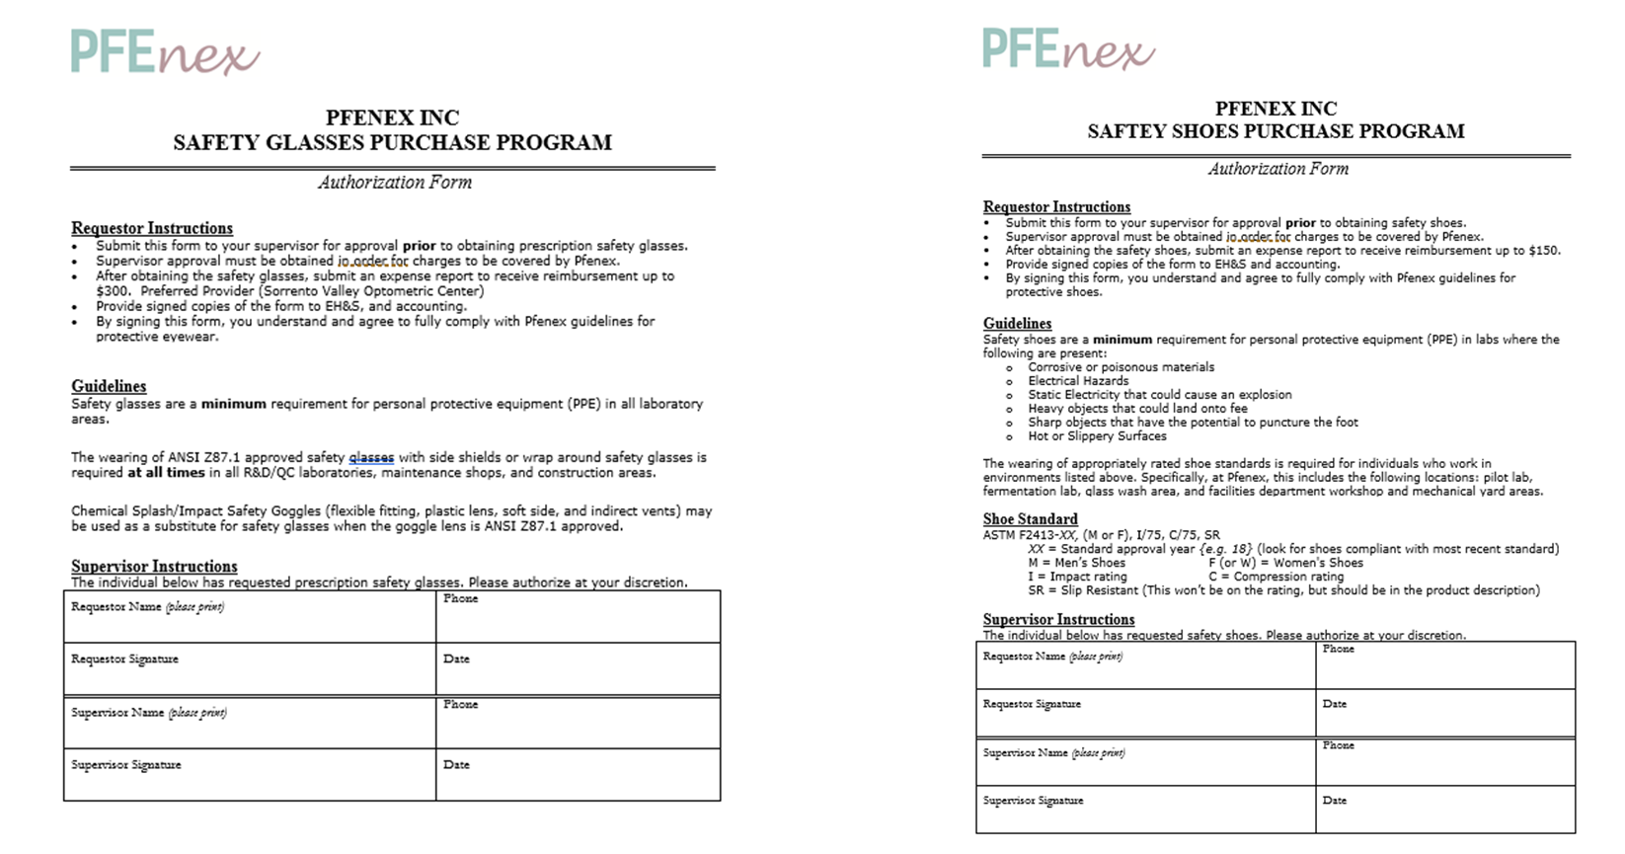
Lab Safety Forms
Function Overview

Slide 20
Function Overview II

Slide 21
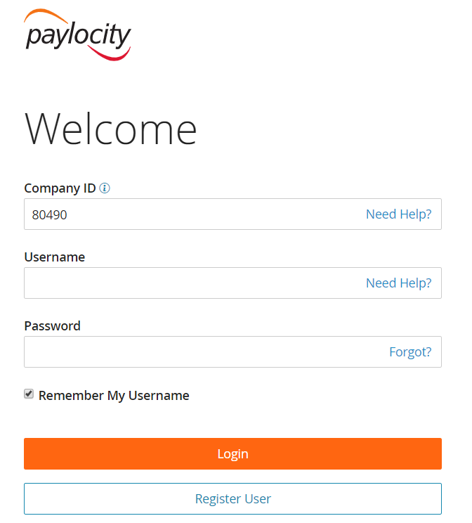
Payroll
Function Overview
Getting Started in Paylocity
Company ID: 80490
Make Updates to:
  Address
  Exemptions
Access Pay Stubs
Do you have questions about Paylocity?
  Email: Payroll@Pfenex.com

Slide 22
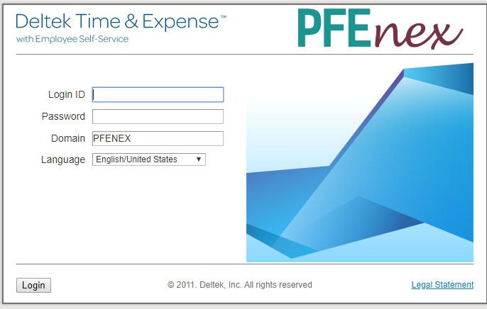
Payroll
Function Overview
Deltek Time & Expense
  Employee pay and expense reimbursements are paid via direct deposit. Pay is for the two weeks ending the previous Saturday.
    E.g., payroll paid Friday, October 18 is for the two weeks ending Saturday, October 12.
  Payroll will send you an email with more detailed information on submitting expense reports during your first week.
  All timesheets and expense reports must be completed and signed by noon Monday for the previous week.
Expense Reports
  Submit expenses within 21 days with ALL receipts
If you have payroll
questions or need additional help:
please contact Payroll@pfenex.com

Slide 23
Payroll
Function Overview
Timekeeping
  Log your hours on a daily basis. This is a requirement for government contractors.
  Accurate department (a/k/a org) coding: Analytical Sciences 1003, TIV-Target ID & Validation 1009, Quality 1012, etc.
  Accurate project coding: 100, 563, 708, etc. – see your supervisor for help

Slide 24
Communications
Function Overview
Corporate Communications is anything we say externally or internally at Pfenex. As a public company, all information disseminated is carefully reviewed and considered prior to release.
We have several ways to communicate as a company:
  Our corporate website
  In.Pfenex
  Our social media channels, including Facebook, LinkedIn and Twitter
  Press releases and public information releases (SEC filings)
  Statements and interviews (released only by approved Pfenex spokespersons)
It is important to recognize that while you are not an official spokesperson of Pfenex, as an employee you are a representative of the company. Any statement that you say externally related to Pfenex ties back to the company directly.
Pfenex encourages employees to share all Pfenex social media content and highlight publicly available work.
All Pfenex external communications must follow approved protocol. If you ever receive an inquiry from a media representative, forward immediately to Patrick Lucy

Slide 25
Purchasing & Contracts
Function Overview
The Purchasing & Contracts Group is responsible for the Procurement of goods and services and for the drafting, review, negotiation and execution of all Contracts.
A Contract is any agreement that creates a binding obligation for Pfenex
  This can include but is not limited to:
    Purchase Orders
    Documents that require a signature
    Documents with Terms & Conditions
All purchases for goods and services should go through the Purchase Requisition Process in CostPoint.
  This can include but is not limited to:
    Goods: materials, chemicals, equipment and supplies.
    Services: repairs, calibration, maintenance (including preventative) and licenses.
All instructions and documents related to Purchasing and Contracts can be found on the Pfenex Intranet at:
  https://in.pfenex.com/contracts-and-purchasing/
If you have any questions please contact us at Purchasing@Pfenex.com

Slide 26







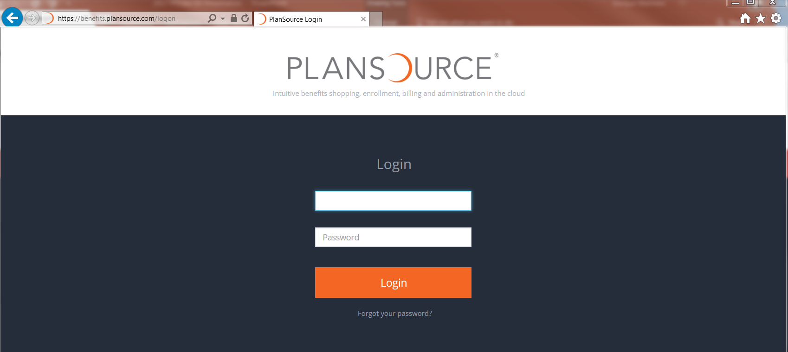
Human Resources & Benefits
Function Overview
My Benefits Plan: we offer a range of options to fit your lifestyle
  The first day of the month following date of hire, you are eligible for benefits.
  Enrollment will be completed in PlanSource and Elections must be made
  within 30 days from date of hire
My Retirement Plan:
  John Hancock will receive your information after completing all onboarding process in Paylocity.
  JH will mail out welcome kit. Sign up online after receiving kit (should receive 3-5 business days).
  You will have the opportunity to elect to contribute to either Roth (after-tax) or Traditional (pre-tax) or a combination of the two up to the maximum limits allowed by the IRS.
  Deferrals will feed to a payroll report and deduction will begin. Pfenex will contribute up to a 4% match on the funds you contribute to your 401(K).
Notes:
401k timelines for when a new hire signs up for the 401k Benefit:
New Hire – Signs up for Plansource benefits; JH is notified and 401k packet kit is mailed out immediately
New hire signs up when they receive their kit, the deferrals will feed to a payroll report
If the New hire enters their deferrals before the pay period ending Thursday, the deductions in payroll will begin on the next pay date (Following Friday)
If the New hire enters their deferrals after the pay period ending Thursday, the deductions in payroll will begin in 2 pay dates.
Once deductions begin, the employer match will also begin immediately on that paycheck.

Slide 27

Talent Acquisition – Pfenex Employee Referral Program
Function Overview
Pfenex Referral Program Amounts:
  $1,000 for all FTE Positions
  $1,500 for business-critical positions
Process:
  The referrer must submit the candidate name, resume (if available), and position to Human Resources via the Careers@pfenex.com e-mail within 3 days of the candidate applying
Eligibility:
  Only FTE employees are eligible to receive the referral bonus
  Sr. Directors, hiring managers, and Human Resources are not eligible
  Candidate must not be a relative or a former Pfenex employee
Payout Criteria:
  New employee must be employed for a full 45 days.
  Referrer must be an active employee at the time of payout

Slide 28
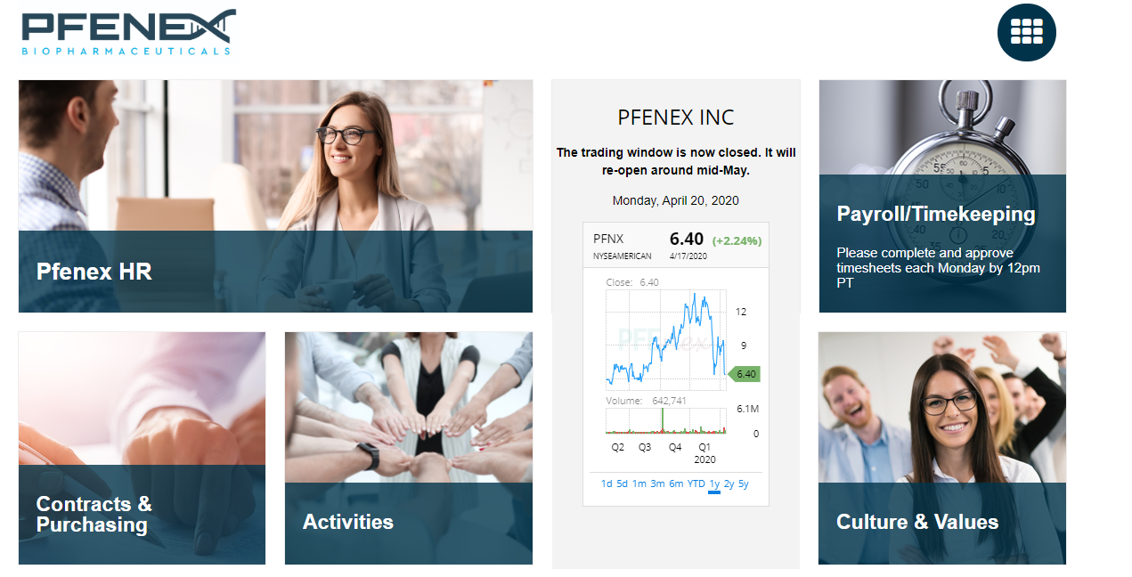
Function Overview
Pfnex Intranet Page
https://in.pfenex.com/

